Slide 1

01 / 32
DiDi
Weekly Performance Report
CX Service Operations · Delivery LOB · Phone and Live Chat
Deliverable 2: CX Quality Analyst business case
1–31 May 2026 · W19–W22
MX · CO · CR · PE
Prepared for CX Leadership

Slide 2
DiDi
Scope, data and assumptions
02 / 32
What this report is built on
Source
Grain: one row is…
Volume
Period
What it answers
QA audits
One audited interaction
2,460
4–29 May
QA score, attribute defects, channel
QA attribute fails
One failed attribute in an audit
518
4–29 May
Pareto of defects, critical vs non-critical
CSAT surveys
One survey answer
77,266
1–31 May
CSAT %, star mix, verbatim comments
Recontact
One contact-reason / channel / day
994,591
1–31 May
Recontact rate, repeat volume by reason
How we treated the data
What this report does not cover
If an attribute is N/A (value 2), we drop it from both the top and the bottom of the score.
Delivery is the only line of business in the data. Cuts by LOB collapse to Business Type.
One fail on a Critical attribute sends the interaction score to 0.
QA covers 14.4% Phone and 85.6% Live Chat. Phone is under-sampled.
Phone is scored on 12 attributes. Live Chat on 8. Never mixed. Official QA does not use the solution/process dropdown.
Recontact covers 12 channels. Only Phone and Live Chat are also audited.
CSAT and recontact are one ratio for the month. Not an average of daily averages.
QA and CSAT share 45 contact reasons. The link between them uses only those.
Agents with fewer than 5 audits do not appear in individual rankings.
Surveys cover the full month. Audits start on 4 May (W19).
DiDi Global, CX Service Operations | Confidential. Internal use only

Slide 3
DiDi
Executive summary
03 / 32
Performance against goal · May 2026
QA SCORE
CSAT (BLENDED)
RECONTACT (GLOBAL)
Week in volume
94.14
79.95%
5.83%
994,591
customer contacts
+9.14 pp vs 85 goal
-5.05 pp vs 85% goal
+0.39 pp vs 5.44% goal
77,266
CSAT surveys
On goal
More than 5 points off
Within 5 points
2,460
QA audits
The 10-second read
Status legend
Two of three metrics missed goal. QA was strong at 94.14, while blended CSAT was below target at 79.95% (Phone 86.3%, Chat 77.6%). Recontact was 5.83%, slightly above the 5.44% goal, although the final week improved to 5.26%.
High QA does not necessarily mean a good customer outcome. Across 45 shared contact reasons, QA and CSAT have almost no relationship (R² = 0.023). Live Chat scores 96.0 on QA but only 77.6% on CSAT, while Phone scores 83.0 on QA and 86.3% on CSAT.
Two gaps stand out in the scorecard. First, 527 audits followed process but did not resolve the case, yet still averaged 96.87 QA. We should keep the agent score but also track whether the case was closed. Second, Chat does not treat correct information as a critical attribute. As a result, 297 of 372 process-fail chats still score 100. Under the proposed scoring change, Chat QA would fall to 80.14.
Green : at or above goal.
Amber : within 5 points of goal.
Red : more than 5 points off goal.
QA is measured against 85. CSAT against 85%. Recontact against 5.44%, and lower is better. That 5.44% goal is on the global rate (all channels). Built on 2,460 audits, 77,266 surveys and 994,591 contacts.
DiDi Global, CX Service Operations | Confidential. Internal use only

Slide 4
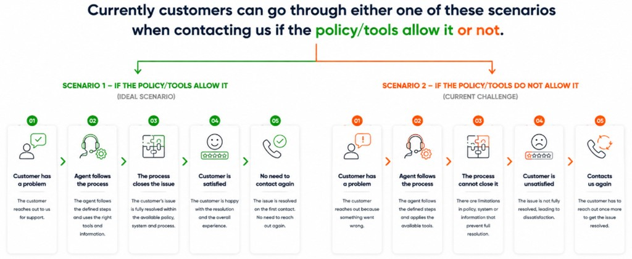
DiDi
Two paths after the same QA step
04 / 32
QA scores step 2. CSAT scores step 4. Recontact is step 5. Close vs CSAT R² 0.64 · QA vs CSAT R² 0.023
What May shows on each path
If policy / tools allow it
If they do not
Step 2 · QA
1,169 audits resolved + followed process · QA 95.86
527 audits not resolved + followed process · QA 96.87
Step 3 · Close
Closed 1,415 of 2,114 assessed (66.9%)
75.4% of not-resolved still followed process · 215 policy + 116 tools
Step 4 · CSAT
Wrong / damaged / inedible / incomplete order: 89–92% CSAT
Order status & delays: 64.7% CSAT despite QA 97.3
Step 5 · Recontact
Those reasons: 2.9–5.2% recontact
Order status & delays: 19.34% (7,680 repeats) · human 15.56%
CSAT is the official ratio of that contact reason, not a ticket score. Both paths can score green on QA. Only the close path lines up with CSAT and recontact.
DiDi Global, CX Service Operations | Confidential. Internal use only

Slide 5
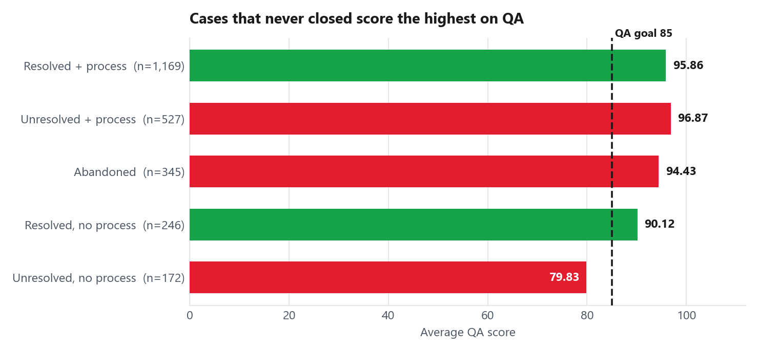
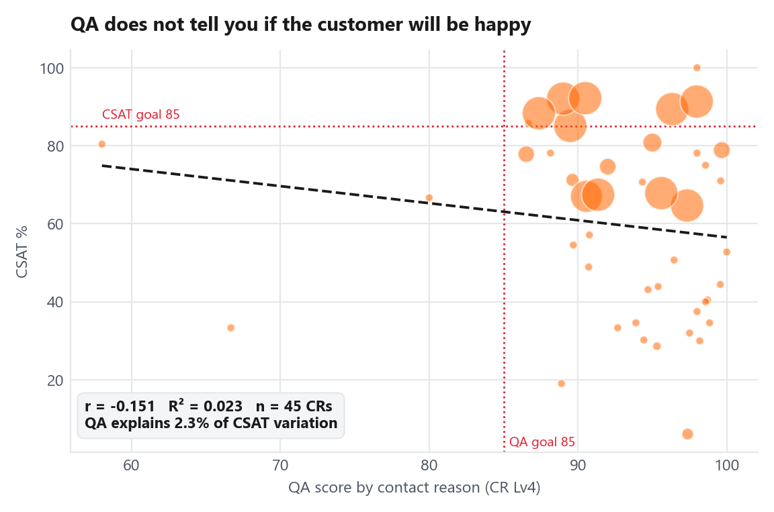
DiDi
The finding that needs a decision
05 / 32
We are scoring the conversation. The customer is scoring the result.
Customer has a problem
→
QA
→
The process cannot close it
→
CSAT
→
Recontact
Agent follows the process
Customer is unsatisfied
Contacts us again
QA stays high even when the case is not resolved
The agent followed process, but the case was not resolved. These 527 audits still averaged 96.87 QA. Keep the agent score, but also track closure. Chat has a second gap: correct information is not scored as a critical attribute. As a result, 297 of 372 process-fail chats still score 100. Under the proposed scoring, Chat QA would be 80.14. Overall, 82.7% of audits currently score exactly 100.
What the audits show
Does higher QA mean better customer outcomes?
527 audits followed process but did not resolve the case, yet still averaged 96.87 QA.
The link between QA and CSAT is -0.151 across 45 contact reasons.
297 of 372 process-fail chats still score 100.
R² is 0.023. QA explains 2.3% of how CSAT varies. Almost none.
Under the proposed scoring, Chat QA would be 80.14, below the 85 goal.
CSAT is much more closely related to whether the case was resolved than to whether the agent followed the current QA process. Adding the Chat attribute would improve measurement, but would not directly improve CSAT.
DiDi Global, CX Service Operations | Confidential. Internal use only

Slide 6
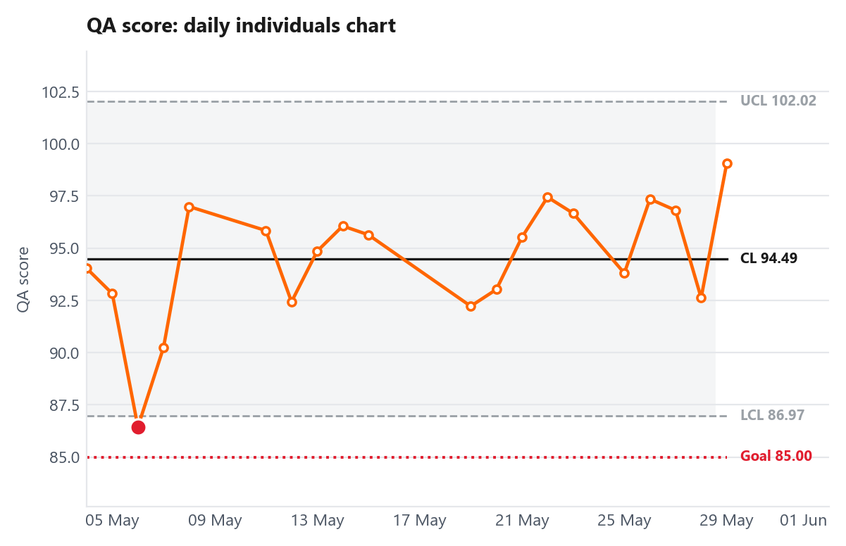
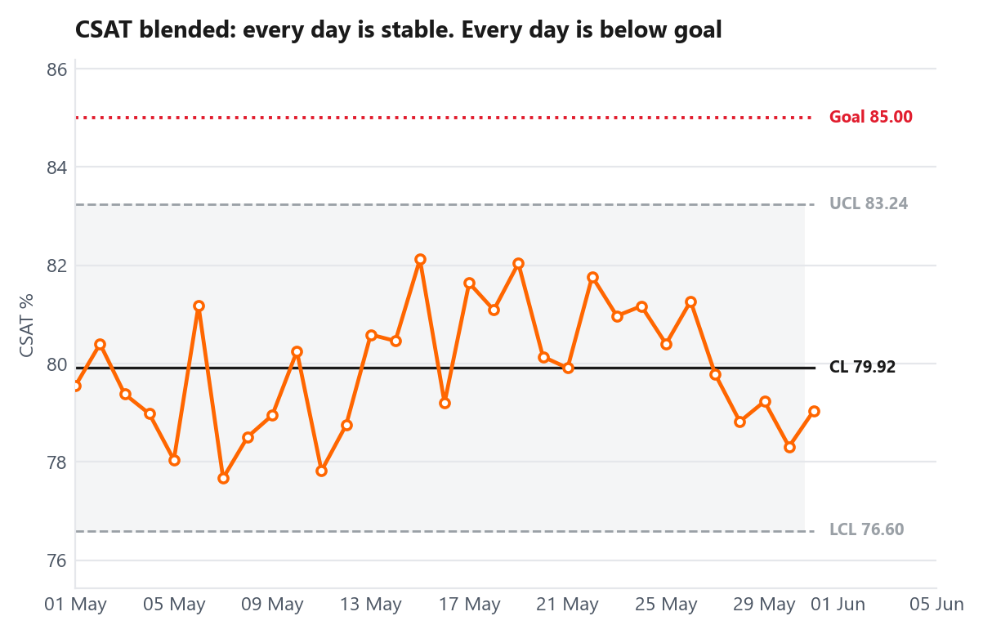
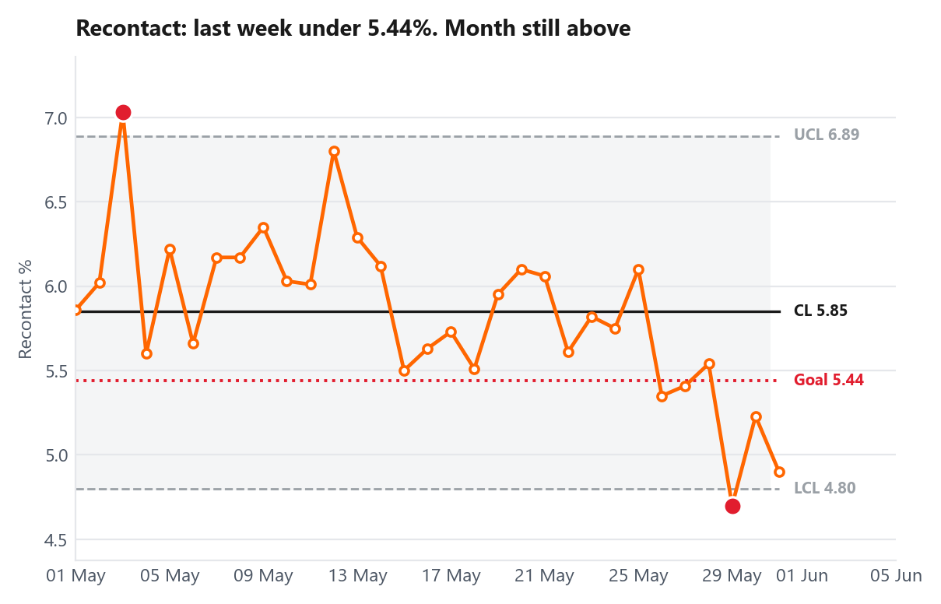
DiDi
Was this a noisy month, or is this the process?
06 / 32
One point per day. Whole month.
QA: one dip on 6 May. Otherwise steady
CSAT blended: steady. Every day below goal
Recontact global: last week under goal. Month still amber
Blended CSAT remained below goal throughout the month
All 31 days stayed within the normal control limits (76.60–83.24), but every day remained below the 85% CSAT goal. This suggests a consistent process issue rather than a single bad day or agent. QA had one notable dip on 6 May (86.44), while recontact improved during the final week to 5.26% (month still 5.83%, above the 5.44% goal).
CSAT is more likely to improve when agents have a clear way to resolve the issue—for example, approving a refund, seeing an ETA, or escalating through a defined path. Coaching alone is unlikely to shift a result that stayed below goal for all 31 days.
DiDi Global, CX Service Operations | Confidential. Internal use only

Slide 7
07 / 32
01
QA analysis
Score against goal by channel and by contact reason. Then the defects behind each gap.
DiDi

Slide 8
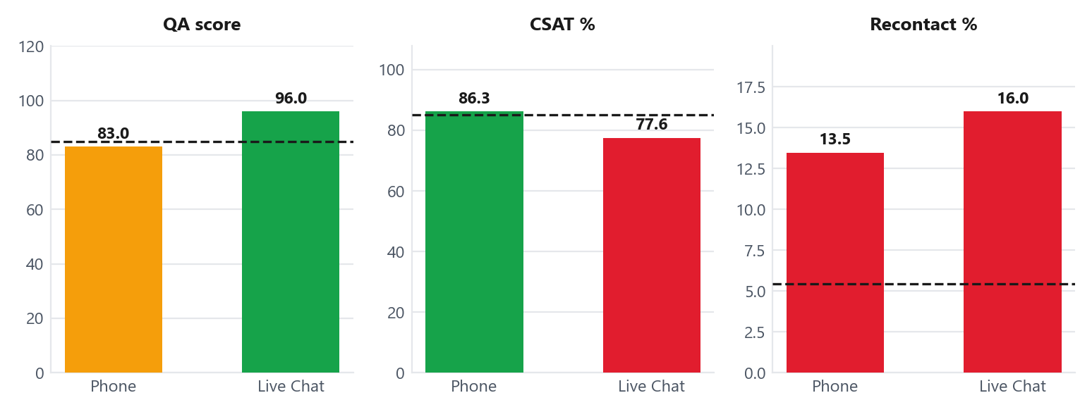
DiDi
QA analysis by channel
08 / 32
Phone and Live Chat scored on their own lists. Never mixed.
Channel
QA
vs 85
Audits
Status
Phone
83.04
-1.96
355
Near goal
Live Chat
96.01
+11.01
2,105
On goal
Why Phone is below the QA goal
Phone handles a higher share of complex issues such as refunds, charges and undelivered orders.
Critical attributes fail in 13.52% of Phone audits, compared with 2.95% in Chat.
Phone represents only 14.4% of audits, so its lower score has limited impact on the overall QA result.
Phone is below goal, while Chat represents most of the QA sample.
Phone QA is 83.04, 1.96 points below goal. Chat is 96.01 and represents 85.6% of audits, which drives the overall QA score to 94.14. Chat also uses a less stringent approach because correct information is not currently a critical attribute. Under the proposed scoring, Chat QA would be 80.14. Despite the lower QA score, Phone has higher CSAT than Chat (86.26% vs. 77.55%).
DiDi Global, CX Service Operations | Confidential. Internal use only

Slide 9
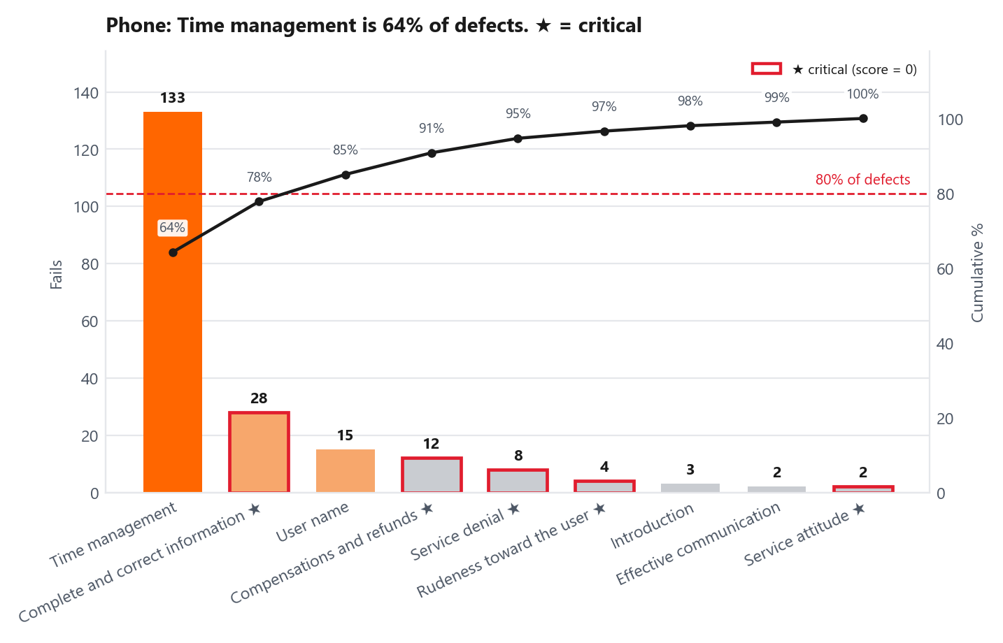
DiDi
QA analysis: Phone
09 / 32
355 audits · 12 attributes · score 83.04 vs 85 goal
Contact reasons with the lowest QA
Contact reason (CR Lv4)
QA
n
Status
Completed but not received — market pla…
47.5
4
Off goal
Active order, already received
65.8
12
Off goal
Paying the courier
66.7
3
Off goal
Completed but not received — full servi…
68.2
49
Off goal
Courier overcharged me
68.6
7
Off goal
What is driving these low scores
What this chart is saying
These five reasons mainly involve disputed charges or undelivered orders. Agents often depend on system information before they can move forward.
Time management accounts for 64.3% of Phone defects (133 fails).
Complete and correct information adds another 28 fails and has a larger score impact (6.55 pp) because it is critical.
Time management is the main issue, followed by complete and correct information.
Together, these two attributes represent 77.8% of Phone defects.
Because that attribute is critical, a failure reduces the score to 0.
Calls can run long without giving the customer a clear next step.
DiDi Global, CX Service Operations | Confidential. Internal use only

Slide 10
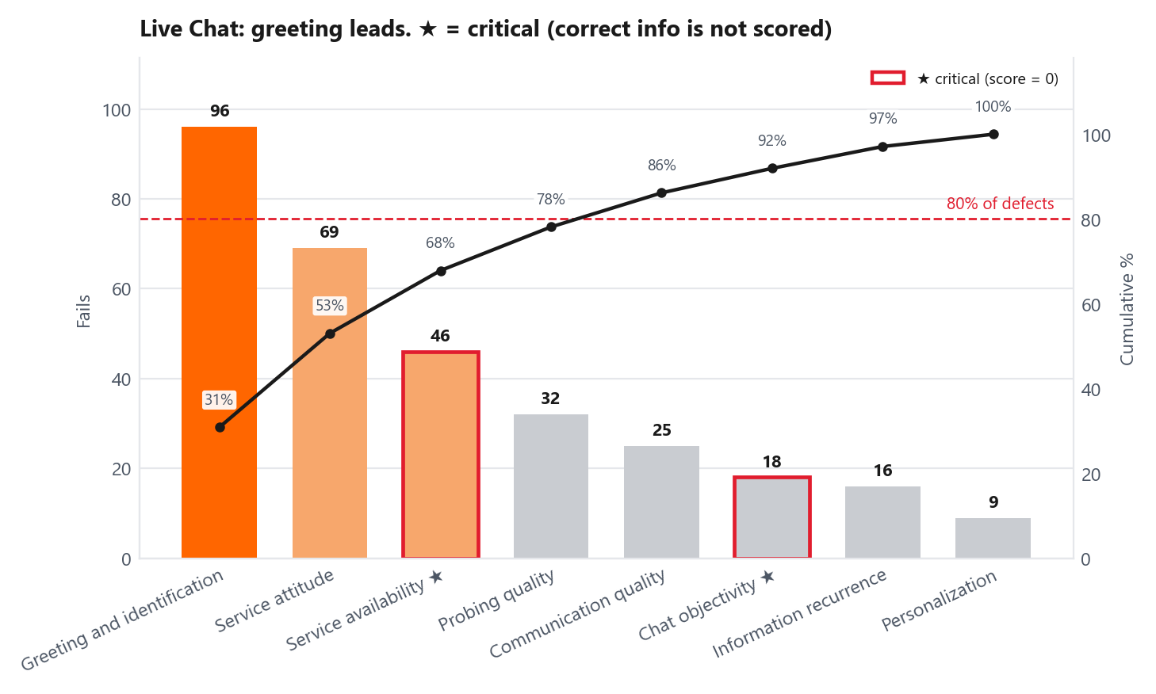
DiDi
QA analysis: Live Chat
10 / 32
2,105 audits · 8 attributes · official score 96.01 vs 85 goal
Contact reasons with the lowest QA
Contact reason (CR Lv4)
QA
n
Status
verbal aggression
76.0
5
Off goal
referral coupon information
80.0
5
Near goal
store registration
80.0
5
Near goal
cancel the order
86.7
9
On goal
modify payment method
86.7
9
On goal
What is driving the gap
What this chart is saying
Chat does not currently treat complete and correct information as a critical attribute, unlike Phone.
Greeting and identification account for 30.9% of Chat defects, followed by service attitude at 22.2%.
As a result, 297 of 372 process-fail chats still score 100.
Service availability has the largest score impact among these defects because it is critical (46 fails, 2.10 pp).
Under the proposed scoring, Chat QA would be 80.14, below the 85 goal.
The current Chat form also does not check whether the agent used the knowledge base or provided correct information.
DiDi Global, CX Service Operations | Confidential. Internal use only

Slide 11
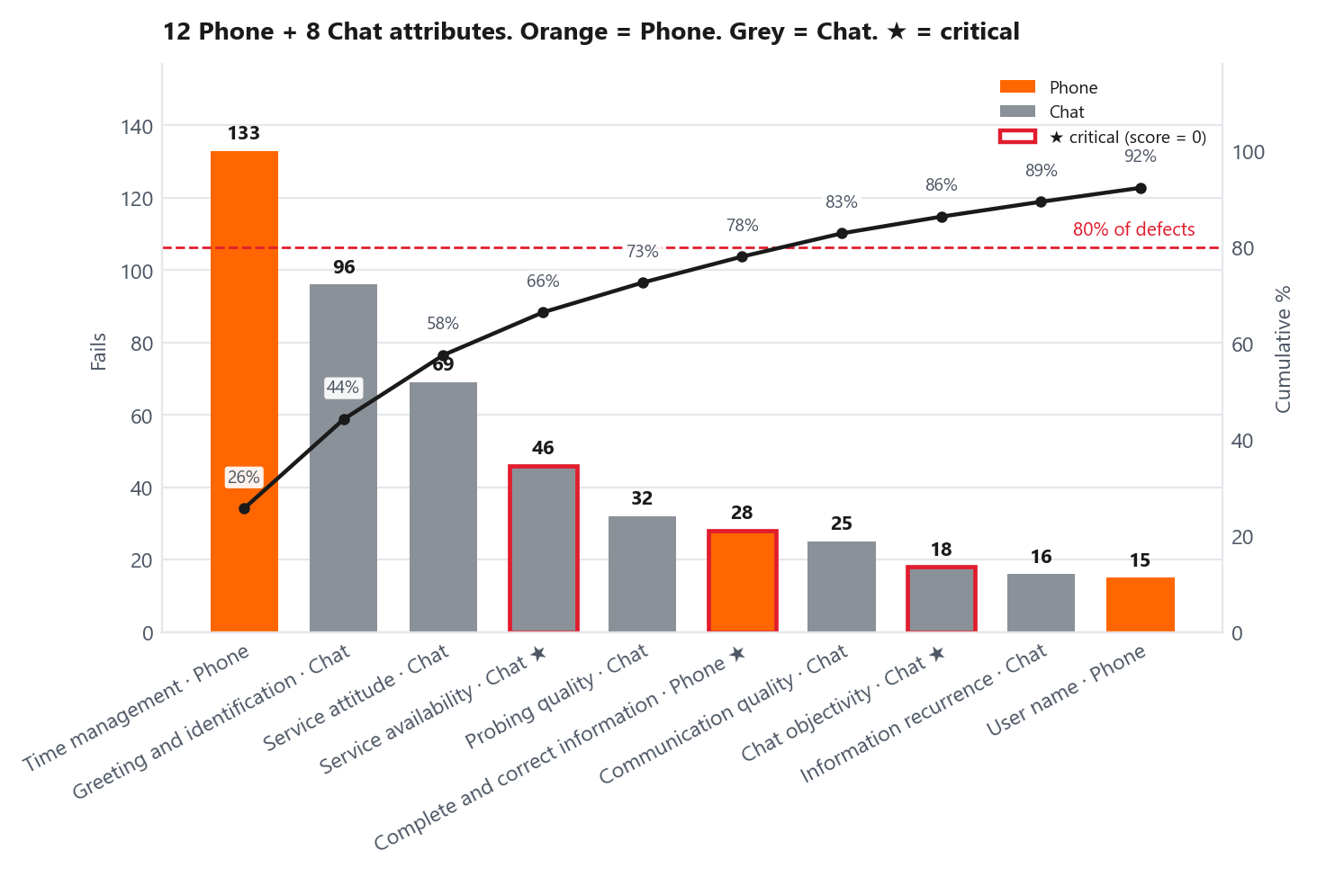
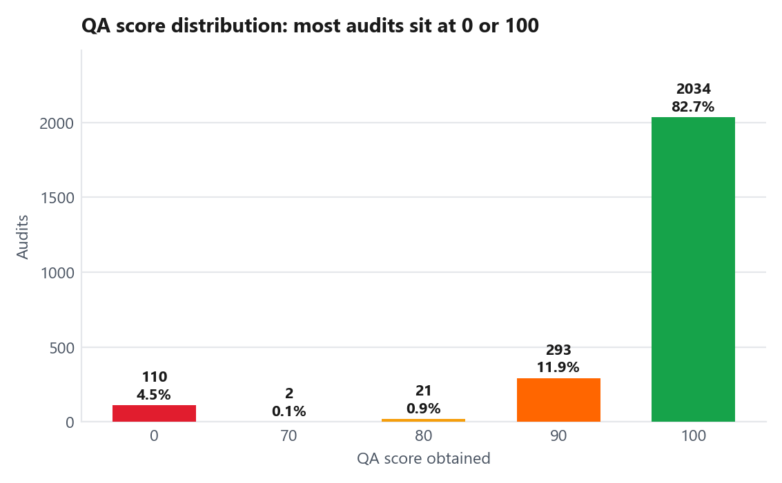
DiDi
QA analysis: where the defects are
11 / 32
20 attributes scored (12 Phone, 8 Chat). Official QA never mixes them. This chart is a blended view.
How the scores are distributed
What this chart is saying
82.7% of audits score exactly 100, while 4.5% score 0 because of a critical failure.
7 bars make 82.8% of all 518 fails. That is not 7 of 20 attributes: Phone and Chat lists are separate (12 + 8).
Very few audits fall between these two extremes, making the current scale behave more like pass/fail than a continuous score.
Orange is Phone. Grey is Chat. ★ is critical: one fail zeroes that audit. Phone criticals: complete information, refunds, denial, rudeness, service attitude. Chat criticals: service availability, chat objectivity.
Time management (Phone, not critical) is the volume leader. Complete and correct information (Phone, critical) is fewer fails but costs more score.
DiDi Global, CX Service Operations | Confidential. Internal use only

Slide 12
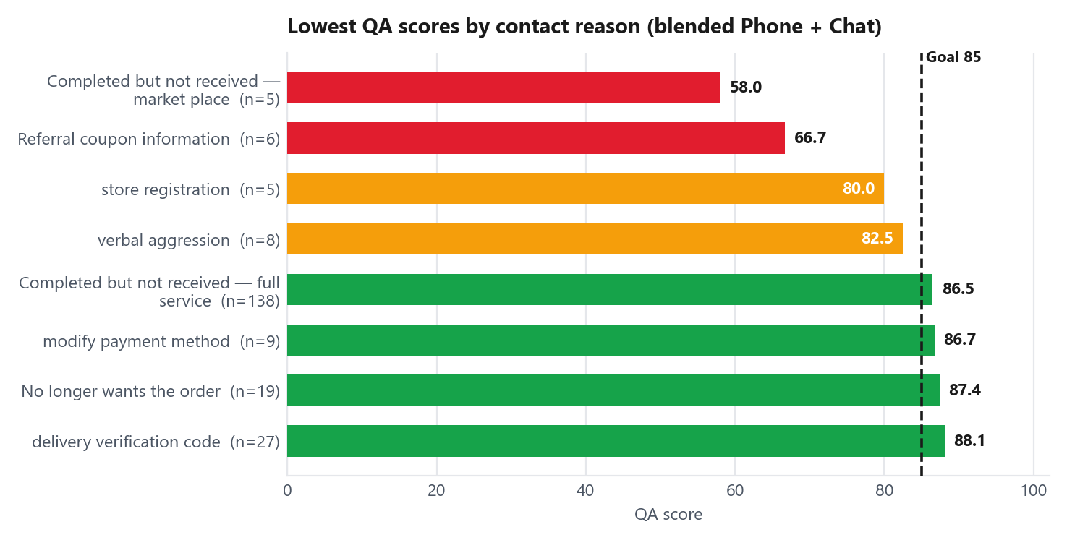
DiDi
QA analysis by contact reason (CR Lv4)
12 / 32
Blended ranking (Phone + Chat together). Official QA never mixes the two lists. At least 3 audits.
Lowest QA reasons (blended)
Contact reason
QA
n
Status
Completed but not received — market p…
58.0
5
Off goal
Referral coupon information
66.7
6
Off goal
store registration
80.0
5
Near goal
verbal aggression
82.5
8
Near goal
Completed but not received — full ser…
86.5
138
On goal
Why two numbers for the same reason
This slide is blended. The Phone slide and the Chat slide are not.
Read Phone and Chat apart before you trust this blended ranking
Verbal aggression looks like 82.5 here (8 audits). Split: Chat 76.0 on 5, Phone 93.3 on 3.
Take “order completed but not received — full service.” On Phone that is 68.2 QA from 49 audits, under the 85 goal. Blend in Chat and the same reason becomes 86.5 from 138 audits, which looks fine. Chat did not fix Phone. It only diluted the average.
Undelivered full-service looks like 86.5 here (138 audits). On Phone alone it is 68.2 on 49.
If you only read the blended number, a red Phone queue can look green.
DiDi Global, CX Service Operations | Confidential. Internal use only

Slide 13
13 / 32
02
CSAT and voice of the customer
Blended CSAT against goal. Then Phone vs Chat. Who is dragging it. What detractors say.
DiDi

Slide 14
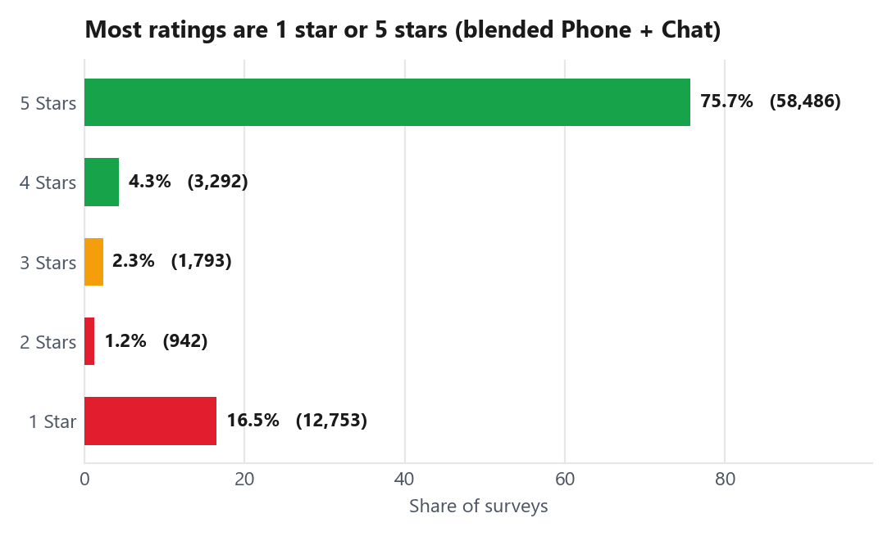
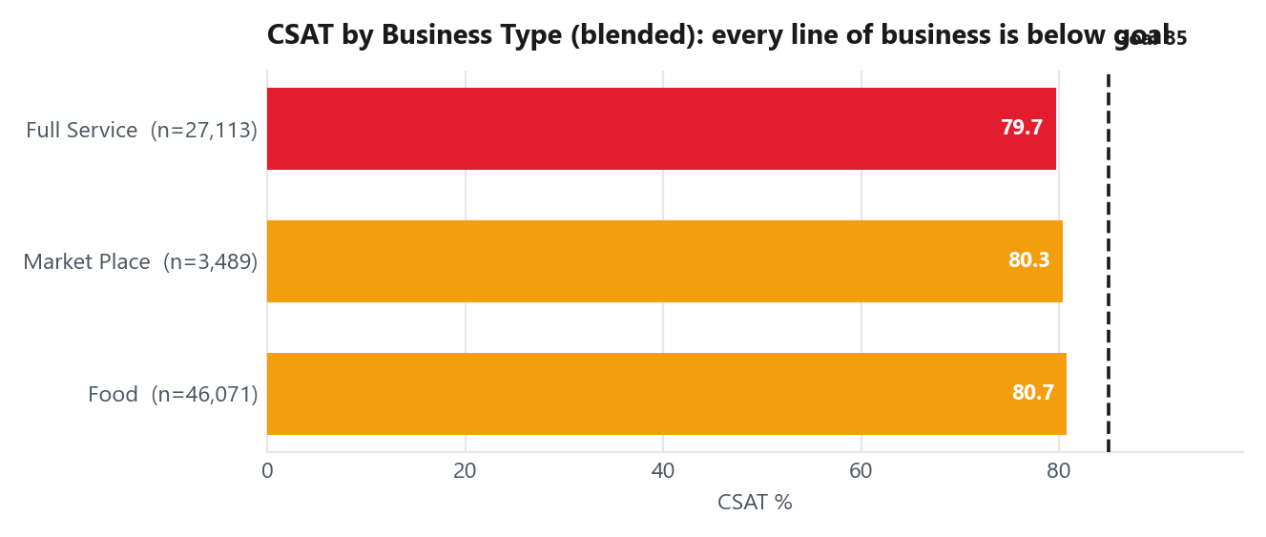
DiDi
CSAT analysis
14 / 32
Blended 79.95% vs 85% · Phone 86.26% · Chat 77.55% · 77,266 surveys
Phone vs Chat vs blended
Channel
CSAT
Surveys
vs 85
Status
Phone
86.3%
21,304
+1.26 pp
On goal
Live Chat
77.6%
55,962
-7.45 pp
Off goal
Blended (official)
80.0%
77,266
-5.05 pp
Off goal
Contact reasons dragging CSAT down (blended)
Contact reason (CR Lv4)
Blended
Phone
Chat
Surveys
Order status / delay inform…
67.8%
80.3%
62.8%
9,918
Disagrees with cancellation…
67.4%
77.6%
63.6%
5,992
order status & delays
64.7%
79.8%
60.3%
5,096
No longer wants the order
88.3%
94.2%
81.9%
10,518
refund status and conditions
67.0%
78.7%
57.0%
3,582
Phone is above the 85% goal. Chat is not. The official 79.95% is the blended number: Chat is what pulls it down.
Stars and Business Type on the left are also blended. 16.5% of surveys are 1 star and 75.7% are 5 stars.
DiDi Global, CX Service Operations | Confidential. Internal use only

Slide 15
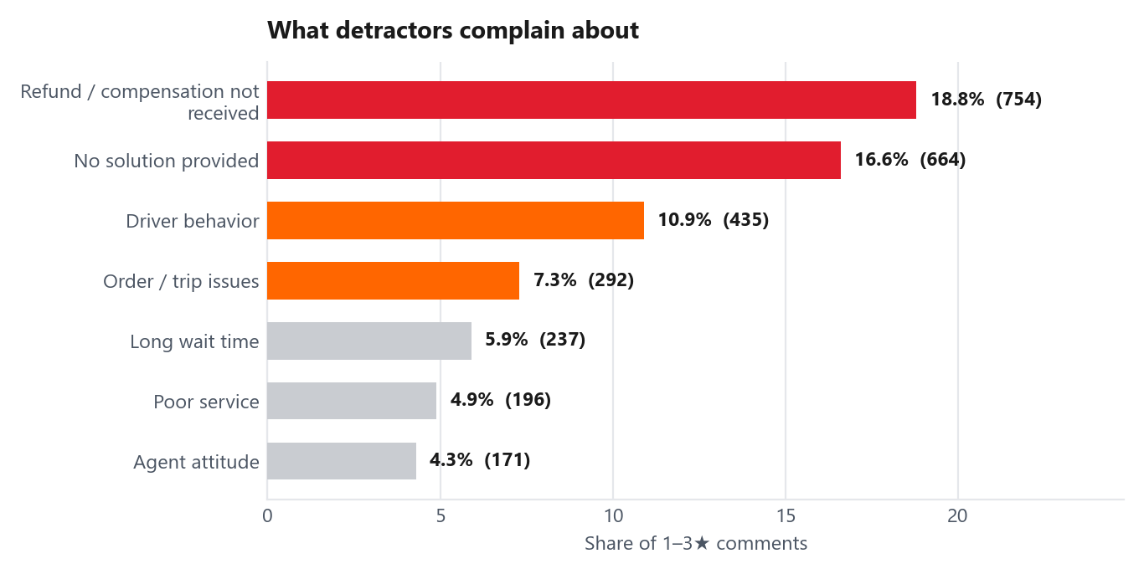
DiDi
Voice of the customer
15 / 32
2,749 classified comments from 1–3★ surveys
What customers are telling us
35.4% of negative comments mention a missing refund or an issue that was not resolved. Agent attitude, which is heavily represented in QA, appears in only 4.3% of these comments.
Customers are mainly describing unresolved issues rather than poor agent behaviour.
Who owns the dissatisfaction
Owner the auditor tagged
Cases
Share
CX Process
54
49.5%
People (CSR)
24
22.0%
Does higher QA mean better customer outcomes?
End User
11
10.1%
QA versus CSAT on 45 shared contact reasons: r = -0.151. R² = 0.023. QA explains 2.3% of how CSAT varies. Almost none. QA versus recontact: r = -0.078. Same story. Improving QA as we score it today would not directly improve CSAT.
External Factors
10
9.2%
DiDi Global, CX Service Operations | Confidential. Internal use only

Slide 16
16 / 32
03
Recontact analysis
Rate against goal. Which channels and contact reasons drive repeat contacts.
DiDi

Slide 17
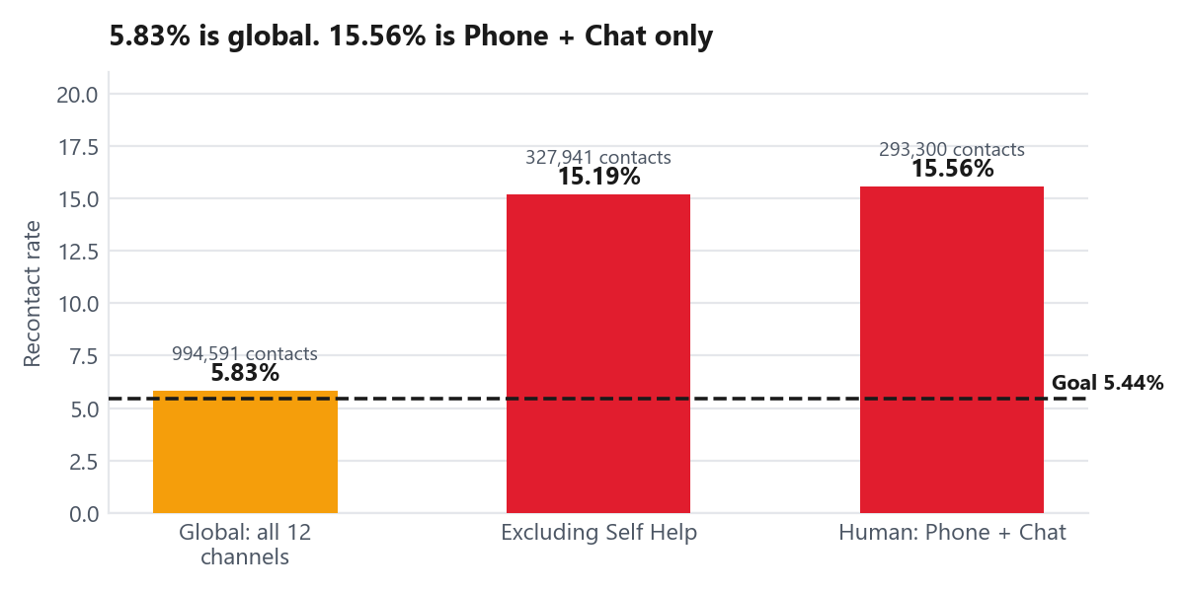
DiDi
Recontact analysis
17 / 32
5.83% is global (all 12 channels) vs 5.44% goal · Human channels (Phone + Chat): 15.56%
Rate by channel: where customers contact us again
Channel
Contacts
Repeats
Rate
Share of repeats
Live Chat
243,626
38,961
15.99%
67.2%
Self Help
666,650
8,154
1.22%
14.1%
Phone
49,674
6,690
13.47%
11.5%
GPTBot
19,508
2,679
13.73%
4.6%
Help Center
12,224
941
7.70%
1.6%
Self Help is heavily influencing the official recontact rate
The official recontact rate is 5.83%, but excluding Self Help raises it to 15.19%, and Phone + Live Chat alone reach 15.56%. This is nearly three times the 5.44% goal. Live Chat generates 67.2% of repeat contacts. Track both figures: the official rate for business reporting and the human-channel rate for operational performance.
Two rates. Do not mix them.
Self Help represents 67% of contacts and has a 1.22% recontact rate, which lowers the official business rate to 5.83%.
Human-assisted channels are much higher at 15.56%.
The official metric is therefore close to goal, while the channels handled by agents remain well above it.
DiDi Global, CX Service Operations | Confidential. Internal use only

Slide 18
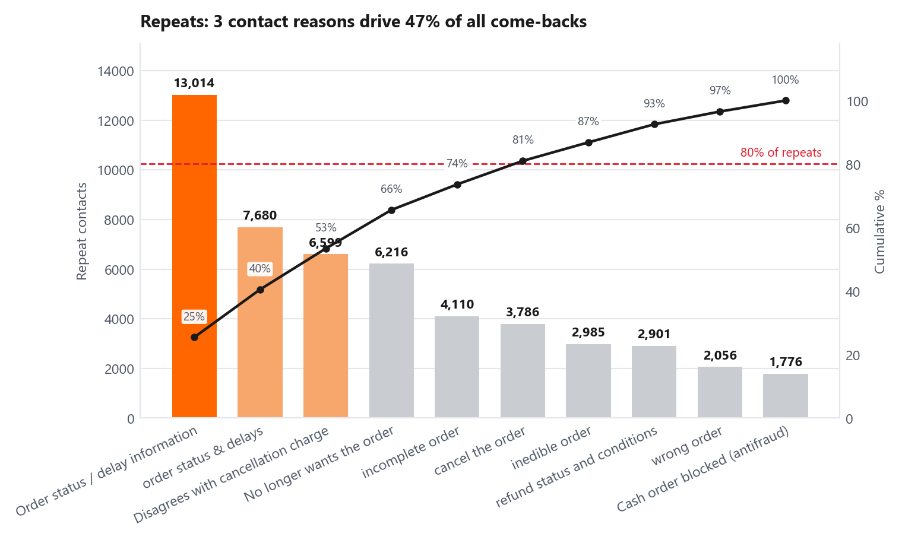
DiDi
Recontact by contact reason
18 / 32
Where customers contact us again
Highest recontact rates
Contact reason
Contacts
Repeats
Rate
Status
After-sales fraud review
3,146
895
28.45%
Off goal
Cash order blocked (ant…
7,278
1,776
24.40%
Off goal
order status & delays
39,706
7,680
19.34%
Off goal
Order status / delay in…
76,911
13,014
16.92%
Off goal
refund status and condi…
18,484
2,901
15.69%
Off goal
Rate = repeats ÷ contacts of that reason. More repeats ≠ higher rate.
How this compares with QA and CSAT
The highest-recontact reasons are not the lowest QA reasons; several score between 93 and 98.
Where the volume sits
However, they also have very low CSAT, especially order status (64.7%) and refunds (67.0%).
Three contact reasons account for 47.0% of all repeat contacts.
This shows that high QA can coexist with low satisfaction and high recontact when the customer still needs to wait for a resolution.
“Order status / delay information” alone represents 22.4% (13,014 repeats).
DiDi Global, CX Service Operations | Confidential. Internal use only

Slide 19
19 / 32
04
People: where coaching should focus
Which agents sit outside the pack. Which teams carry the coaching load.
DiDi

Slide 20
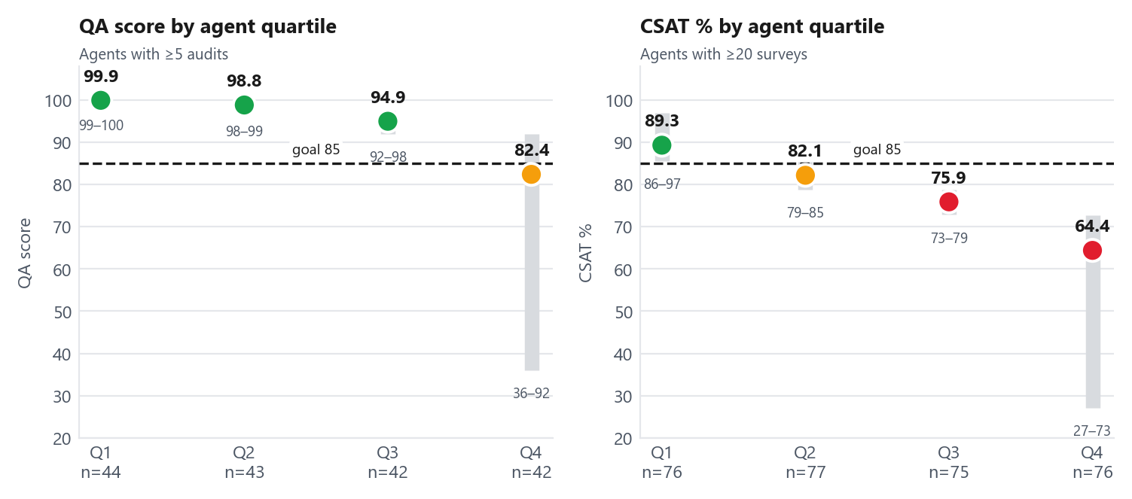
DiDi
Who needs attention: agent quartiles
20 / 32
171 agents with at least 5 audits ranked on QA, 304 with at least 20 surveys ranked on CSAT
The agents who sit outside the pack
Agent
QA
Audits
Team
Coaching priority
Agent 228
36.0
5
S13
245
Agent 21
61.7
6
S9
140
Agent 135
66.7
6
S12
110
Agent 44
71.4
7
S7
95
Agent 171
80.0
17
S20
85
Where coaching should focus
QA shows limited differences between agents, while CSAT reveals a much wider performance gap.
Focus on QA: the 42 agents in Q4 (mean 82.4, range 36–92).
Quartiles 1 to 3 sit at 99.9, 98.8 and 94.9. Three quarters of the floor look the same on QA. The same agents spread from 27.1% to 96.9% on CSAT. Ranking agents by QA identifies very few meaningful differences. CSAT reveals a much clearer group of low performers. A Chat score of 100 does not necessarily mean the process was followed. 88% of Chat audits reach the score ceiling.
Focus on CSAT: the 76 agents in Q4 (mean 64.4%). That group is larger. Mostly different people.
26 agents sit below the 85 QA goal. The top 5 carry 55% of the total coaching priority.
'More than 1 year' is the only tenure below the QA goal (83.97). It is also the worst CSAT group (74.1%).
DiDi Global, CX Service Operations | Confidential. Internal use only
DiDi Global, CX Service Operations | Confidential. Internal use only · Coaching priority = (85 − QA) × audits, summed. Higher = coach this team/agent first. It weights a real sample, not a one-off.

Slide 21
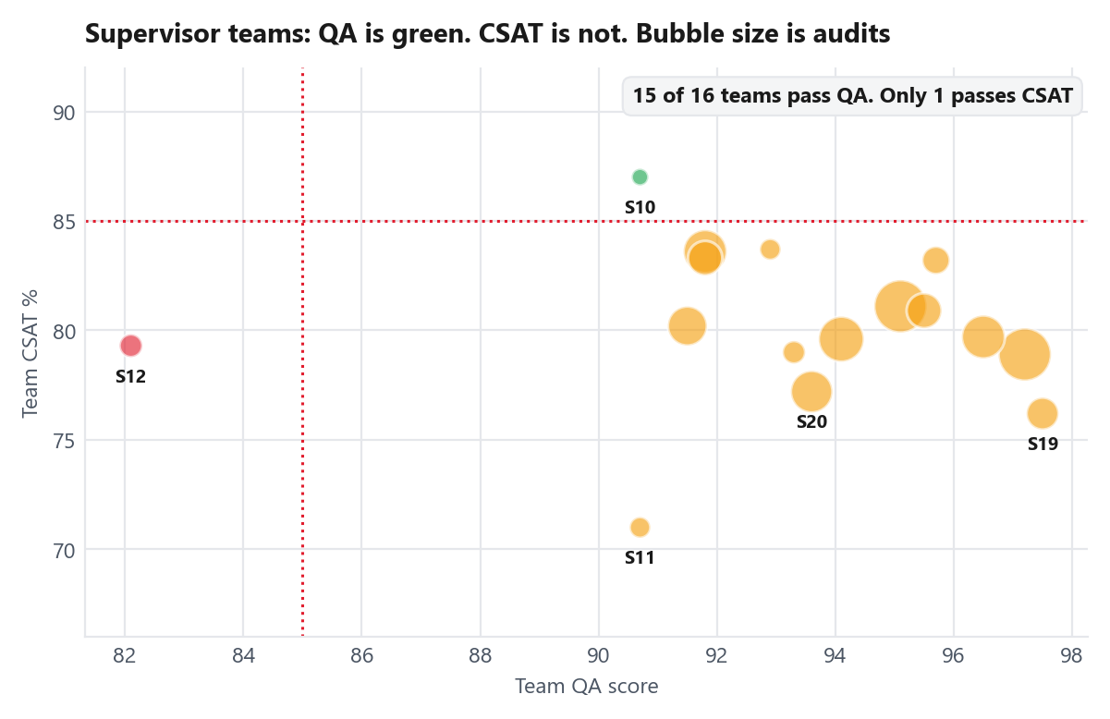
DiDi
Who needs attention: supervisor view
21 / 32
31 supervisors. Bubble size is audits. Teams with at least 20 audits.
Coaching queue: teams with the most agents below the QA goal
Team
Below QA 85
Audits
Worst QA
Coaching priority
S13
3
22
36.0
280
S9
3
16
61.7
220
S20
2
28
79.1
150
S7
4
23
71.4
145
S12
2
12
66.7
120
What the team view shows
Five teams account for 14 of the 26 agents below goal, so the coaching need is concentrated in a small number of teams rather than spread across the floor.
Agent 212 is large enough to name on their own
Supervisor 12 is the only team below the QA goal (82.1 on 53 audits).
Agent 212 has CSAT of 27.1% on 564 surveys. 411 of those customers were unsatisfied (1–3 stars). That is 2.7% of all unsatisfied surveys in the month. No QA audit flagged this agent.
Supervisor 11 passes QA at 90.7. CSAT comes back at 71.0% on 4,243 surveys. Worst of any team.
Supervisor 7 has 43% of its ranked agents in Q4. This suggests a team-level performance pattern rather than a single-agent issue.
DiDi Global, CX Service Operations | Confidential. Internal use only

Slide 22
22 / 32
05
Combined analysis and root cause
Where QA, CSAT and recontact miss on the same contact reason. Then why.
DiDi

Slide 23
DiDi
Combined analysis
23 / 32
Contact reasons that miss on more than one metric (blended Phone + Chat)
Contact reason (CR Lv4)
QA
Audits
CSAT
Recontact
Repeat volume
Surveys
Pattern
Priority
Order status / delay information
95.6
25
67.8%
16.92%
13,014
9,918
Low CSAT + High Recontact
Act this quarter
order status & delays
97.3
45
64.7%
19.34%
7,680
5,096
Low CSAT + High Recontact
Act this quarter
Disagrees with cancellation charge
91.4
59
67.4%
12.96%
6,599
5,992
Low CSAT + High Recontact
Act this quarter
Refund status and conditions
90.6
70
67.0%
15.69%
2,901
3,582
Low CSAT + High Recontact
Act this quarter
Cash order blocked (antifraud)
93.6
58
n/a
24.40%
1,776
n/a
High Recontact
Monitor
After-sales fraud review
97.4
118
6.1%
28.45%
895
475
Low CSAT + High Recontact
Monitor
QA and CSAT columns are blended Phone + Chat. Refund status QA 90.6 is n=70 (Phone 76.4 n=25 + Chat 98.4 n=45): same contact reason, two casings in the source. Official overall QA still keeps the two attribute lists unmixed.
Who the auditor tagged as owner
The same pattern is visible in a single contact reason
49.5% of tagged dissatisfaction is attributed to CX Process, compared with 22.0% to the agent.
“Order status & delays” scores 97.3 on QA, but only 64.7% on CSAT and has a 19.34% recontact rate. It generated 7,680 repeat contacts during the month. Agents follow the process, but they cannot see or change the courier ETA. The interaction is compliant, yet the customer still has no resolution.
42.2% of cases are marked “not resolution-based.”
Only 17.0% are identified as process failures, and Chat QA may understate these because 88% of Chat audits still score 100.
DiDi Global, CX Service Operations | Confidential. Internal use only

Slide 24
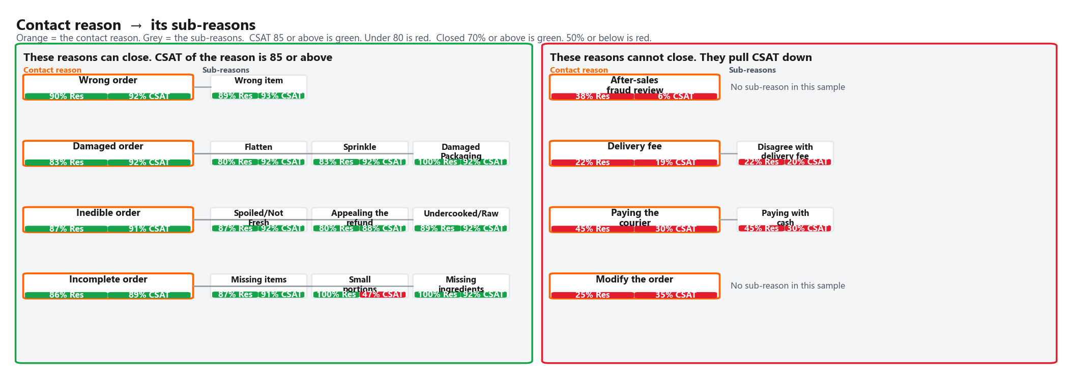
DiDi
Where we can close the case, CSAT is higher
24 / 32
By contact reason and its sub-reasons. Same green / amber / red as the rest of the deck.
Look at the type of issue, not only the agent.
Orange is the contact reason. Grey is the sub-reason. Across 35 contact reasons (at least 3 audits and 20 surveys), closure rate has a strong relationship with CSAT (r = +0.80; R² = 0.64). By comparison, QA and CSAT have almost no relationship (R² = 0.023).
Reasons with higher closure rates
Reasons with lower closure rates
Contact reason (Lv4)
Resolved
CSAT
Audits
Surveys
Contact reason (Lv4)
Resolved
CSAT
Audits
Surveys
Wrong order
90%
92.2%
40
7,359
After-sales fraud review
38%
6.1%
115
475
Damaged order
83%
92.1%
47
5,962
Delivery fee
22%
19.0%
9
21
Inedible order
87%
91.3%
190
7,685
Paying the courier
45%
30.2%
29
96
Incomplete order
86%
89.4%
171
8,227
Modify the order
25%
34.6%
12
52
After-sales fraud CSAT 6.1% is 29 satisfied / 475 surveys (432 ones). That is real. Not a small-sample fluke. One exception remains: “Refund status and conditions” has a 76% closure rate but only 67.0% CSAT on 3,582 surveys, showing that closure alone does not explain every customer outcome.
DiDi Global, CX Service Operations | Confidential. Internal use only
DiDi Global, CX Service Operations | Confidential. Internal use only · Audits on this slide = Resolved or Not resolved. After-sales fraud: 115 assessed, 3 Abandoned, 118 in Combined analysis.

Slide 25
DiDi
5 whys: why we could not close, and what closing actually was
25 / 32
What the auditor wrote in the 5-whys · 699 not closed · 1,415 closed · not a KPI
Cases that could not be closed · n = 699 · 527 still followed process
CSAT of these contact reasons is 52.1%. Not those tickets. Audits and surveys do not share a ticket ID.
Cases that were closed · n = 1,415 · how they were resolved
CSAT of these contact reasons is 70.9%. Not those tickets. Audits and surveys do not share a ticket ID.
Why it did not close
Audits
Share
Of those, followed process
What closing was
Audits
Share
Policy blocked refund / close
267
38%
215
Confirmed a refund or compensation
662
47%
No tool — must escalate
158
23%
116
Explained / confirmed the process
124
9%
Other / unclear
103
15%
77
Used a tool or filed a report
156
11%
No analysis (“No aplica”)
88
13%
63
Other / unclear
251
18%
Fraud named in the text
25
4%
19
No analysis (“No aplica”)
145
10%
Courier / store / restaurant
18
3%
12
Cancellation processed
43
3%
Model: no low CSAT to analyse
14
2%
8
Model: no low CSAT to analyse
34
2%
Delay / ETA (undercounted)
17
2%
12
Agent missed the process
9
1%
5
The main blockers are policy and tools, not agent greetings.
When cases are closed, the resolution usually involves a refund, an explanation, or a tool
Policy: ¿Por qué el cliente está insatisfecho? Porque el agente no resolvió su problema. ¿Por qué no hubo resolución? Porque el agente indicó que un reembolso no era posible. ¿Por qué no era posible? Porque la política Tools: ¿Por qué el cliente está insatisfecho? Porque el pedido está muy retrasado y tiene hambre. ¿Por qué el pedido está retrasado? Porque ya pasaron 2 horas y no lle
¿Por qué el cliente se sintió satisfecho? Porque el agente confirmó el reembolso de su pedido. ¿Por qué el agente confirmó el reembolso? Porque revisó la información del pedido y el estado del reembolso. ¿Por qué revisó la información? Porque el cliente proporcionó los datos soli
DiDi Global, CX Service Operations | Confidential. Internal use only

Slide 26
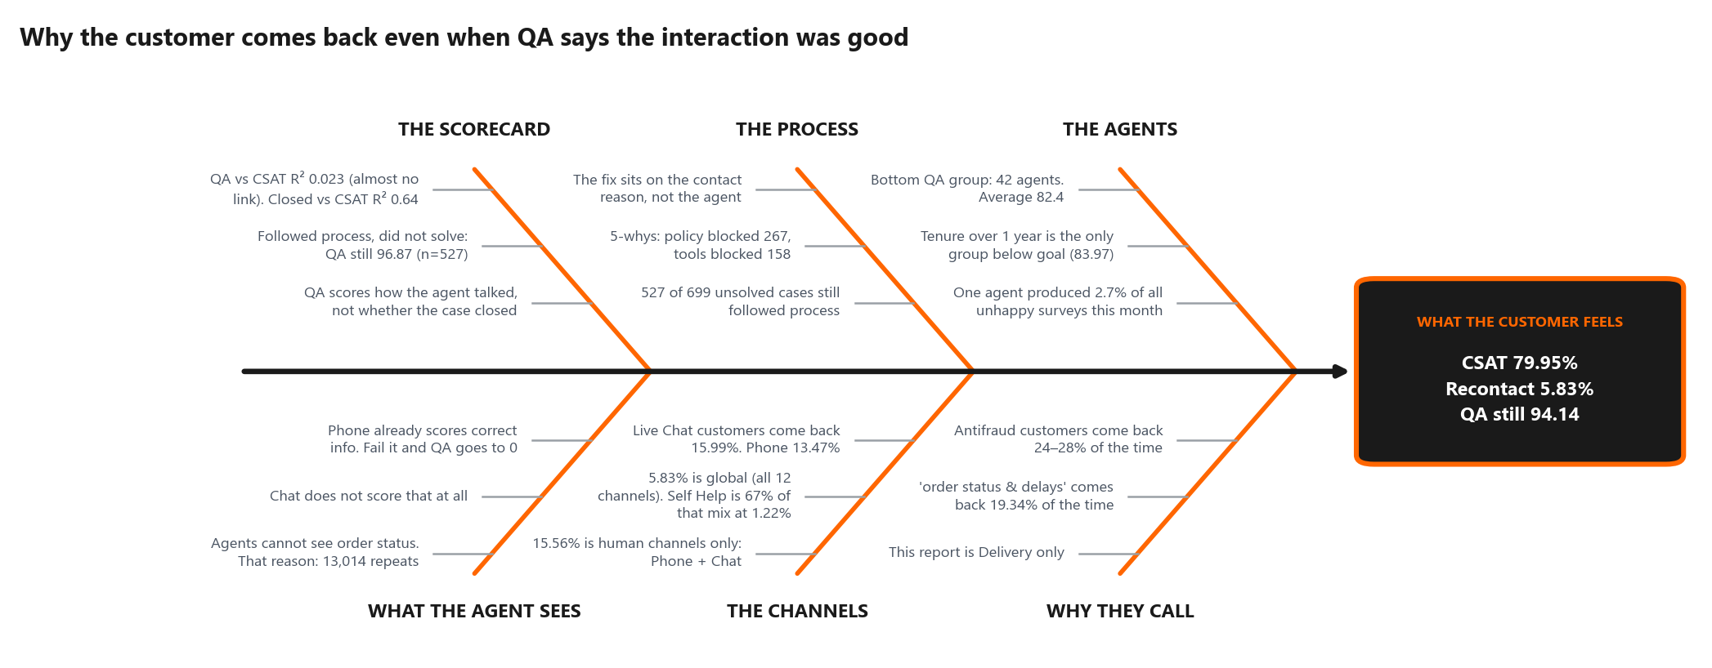
DiDi
Why customers contact us again even when QA is green
26 / 32
Fishbone. Six buckets. Every line has a number.
The key takeaway
The scorecard measures how the interaction was handled, while CSAT reflects the customer outcome. That is why QA is 94.14 while blended CSAT is 79.95%, with almost no relationship between them (R² = 0.023). Of 699 cases marked as not closed, 527 still followed process. The main barriers identified are policy and tools. The priority should therefore be fixing the contact reason, not only coaching agent behaviour.
DiDi Global, CX Service Operations | Confidential. Internal use only

Slide 27
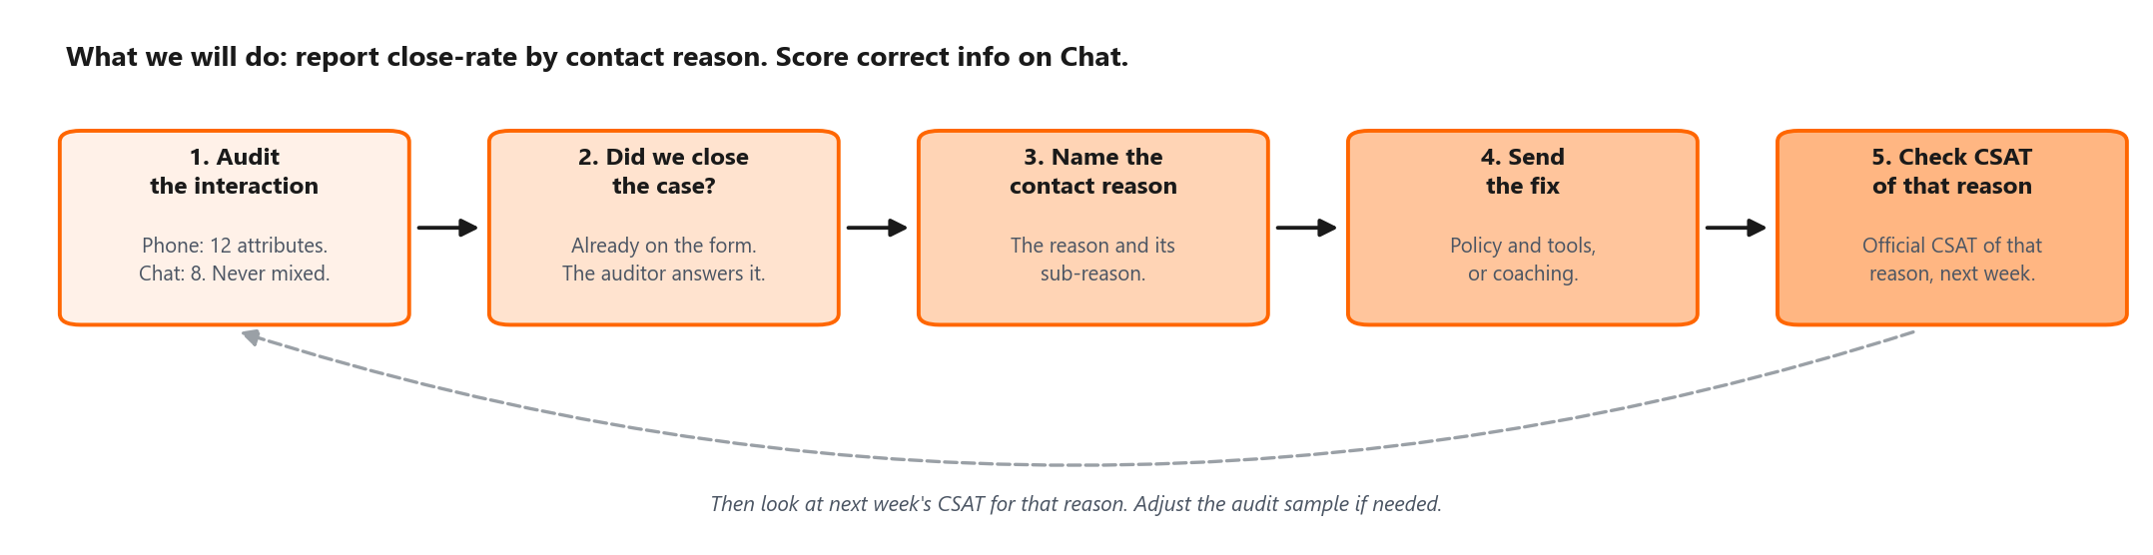
DiDi
What we will do next
27 / 32
Connect QA with the customer outcome
What changes
How we will know it worked
Report closure rate alongside QA by contact reason and sub-reason. Use the same status logic: 70%+ closure is green and 85%+ CSAT is green.
Measure
Today
Target
Horizon
Assign each improvement to the relevant contact reason. The Dissatisfaction_Owner field only appears in about 4% of audits, so it should not be used as the primary ownership map.
QA vs CSAT (R²)
R² 0.02
R² 0.25 or above
2 quarters
Close-rate vs CSAT (R²)
R² 0.64
Keep 0.50 or above
ongoing
Add correct information as a critical Chat attribute to improve measurement accuracy. Under this scoring, Chat QA would be 80.14. This improves the scorecard, but does not directly improve CSAT.
CSAT
79.95%
85.0%
2 quarters
Track the official CSAT for each targeted contact reason to measure whether the change is working.
Recontact (human: Phone + Chat)
15.56%
10.0%
1 quarter
Phone share of audits
14.4%
30%
1 month
DiDi Global, CX Service Operations | Confidential. Internal use only

Slide 28
28 / 32
06
Action plans
What must change. Who owns it. When it lands.
DiDi

Slide 29
DiDi
Action plan by Business Type
29 / 32
Delivery is the only line of business in the data. Plans are cut by Business Type.
Business Type
Evidence
What must change
Who
When
Problem severity
Food
CSAT 80.74% on 46,071 surveys; order status repeats at 19.34%
Add a live courier ETA to the agent console so customers receive a verifiable status.
CX Ops + Product
30 Jun
Critical
Full Service
CSAT 79.67%, the lowest of the volume lines; undelivered orders audit at 68.2 on 49 audits
Give Phone agents limited same-call refund authority for eligible undelivered orders
CX Ops + Finance
15 Jul
Critical
Market Place
CSAT 80.34% on 3,489 surveys; worst Phone QA reason (47.5) but on only 4 audits
Define a clear merchant-escalation SLA and script for “completed but not received.” Low confidence: run 20+ audits on this reason before committing merchant-side resources
Merchant Ops
15 Jul
High
All Business Types
Refund or compensation not received is 18.8% of negative verbatims
Send an automatic notification whenever refund status changes
Product + CX Ops
31 Jul
High
Data quality
'Other' Business Type holds 558 surveys at 26.5% CSAT
Fix the CR-to-Business-Type mapping so detractors are correctly classified
CX Analytics
20 Jun
Moderate
Severity rates how large the gap is. None of these actions has started yet.
Market Place. That case rests on a contact reason with only 4 audits, the same low-volume reason flagged as unreliable in the Phone QA section. Validate with more audits before committing resources.
DiDi Global, CX Service Operations | Confidential. Internal use only
DiDi Global, CX Service Operations | Confidential. Internal use only · Owners are role-level; names to be confirmed with CX Leadership at the weekly review.

Slide 30
DiDi
Action plan by channel, people and governance
30 / 32
Owner, deadline and the severity of the problem behind each action
Scope
What must change
Why now
Who
When
Problem severity
Phone
Increase Phone QA coverage to at least 30%
Phone is 14.4% of audits and the only channel below goal
QA Lead
13 Jun
Critical
Phone
Coach Time Management using a system-check script for money disputes
64.3% of Phone defects, 133 fails
Supervisors
27 Jun
High
People
Run weekly coaching for the 42 QA-Q4 agents, starting with the five teams with the highest concentration
26 agents below the QA goal; Supervisor 13 alone carries three
Supervisors + QA Lead
20 Jun
High
Live Chat
Add a Chat critical attribute for correct information, aligned with Phone
372 chats did not follow process; 297 still score 100. Current Chat QA: 96.01. Adjusted QA under proposed scoring: 80.14
QA Lead
30 Jun
Critical
Live Chat
Do not add Chat headcount. The 15.99% sits on contact reasons that cannot close, mainly order status and refunds.
Live Chat generates 67.2% of every repeat contact in the business
CX Ops
15 Jul
Critical
QA governance
Report closure rate weekly and assign an owner to every unclosed case
The field is already on the form. Followed process, did not solve, still averages 96.87 on QA
QA Lead + CX Head
31 Jul
Critical
QA governance
Report QA and recontact weekly by channel, including Phone+Chat vs the official global rate
Blended figures hid a 13-point channel gap and a 10-point recontact gap
CX Analytics
13 Jun
Moderate
Tagged actions — one action can serve two KPIs. Unique list is on the matrix.
Fix what we measure vs what the customer gets
QA
94.14
8 actions
QA Lead
Closure reporting and the Chat critical change the scorecard. ETA, refund authority and refund notifications change the outcome. Do not mix those two. See the action matrix.
CSAT
79.95%
6 actions
CX Ops
Recontact
5.83%
4 actions
CX Ops
DiDi Global, CX Service Operations | Confidential. Internal use only

Slide 31
DiDi
Action matrix by KPI
31 / 32
Each action once. Outcome changes the customer result. Measure changes the scorecard.
What we will do
Why
Type
QA
CSAT
RC
Who
Live courier ETA in the agent console
Order status & delays: QA 97.3, CSAT 64.7%, recontact 19.34%, 7,680 repeats.
Outcome
—
Yes
Yes
CX Ops + Product
Same-call refund authority for undelivered orders
Phone undelivered full-service QA is 68.2 (n=49). Agents wait on a refund they cannot approve.
Outcome
Yes
Yes
—
CX Ops + Finance
Merchant SLA for completed-not-received (validate n first)
Phone QA 47.5 on n=4. Too few audits to treat as a proven process yet.
Outcome
Yes
Yes
—
Merchant Ops
Automatic refund-status notifications
35.4% of negative comments are unresolved refunds or unsolved issues, not agent attitude (4.3%).
Outcome
—
Yes
Yes
Product + CX Ops
Fix CR to Business Type mapping
'Other' CSAT is 26.5% on 558 surveys. That mix hides real detractors.
Data
—
Yes
—
CX Analytics
Increase Phone QA coverage to 30%
Phone QA 83.04 on only 14.4% of audits. The blend is Chat-weighted.
Measure
Yes
—
—
QA Lead
Coach Phone Time Management
Time management is 64.3% of Phone defects (133 fails).
Coach
Yes
—
—
Supervisors
Weekly coaching for 42 QA-Q4 agents
42 agents in QA Q4; 26 below goal. This lifts QA, not CSAT.
Coach
Yes
—
—
Supervisors + QA Lead
Chat critical: correct information
297 of 372 process-fail chats still score 100. Proposed Chat QA 80.14. Measurement only — does not lift CSAT.
Measure
Yes
—
—
QA Lead
Do not add Chat headcount (15.99% is a process gap)
This report already explains the 15.99% (Chat is 67.2% of repeats). Fix the path, do not staff the wait.
Constraint
—
—
Yes
CX Ops
Weekly closure rate + owner on unclosed cases
527 followed process and did not close (QA 96.87). Closure vs CSAT R² 0.64; QA vs CSAT R² 0.023.
Measure
Yes
Yes
—
QA Lead + CX Head
Weekly QA and recontact by channel (human vs global)
Official recontact 5.83% vs human 15.56%. Phone QA 83.04 vs Chat 96.01. Do not mix them.
Measure
Yes
—
Yes
CX Analytics
12 unique actions. Tagged 8 to QA, 6 to CSAT, 4 to Recontact (a shared action counts in more than one column). Coach = agent skill. Outcome = customer result. Measure = how we score. Constraint = what we will not do.
DiDi Global, CX Service Operations | Confidential. Internal use only

Slide 32
DiDi
The recommendation
32 / 32
Process compliance looks healthy. Customer outcome does not.
What this month is telling us
Our operation looks healthy when we measure agent process compliance (QA 94.14), but the customer outcome tells a different story. Blended CSAT is 79.95% against 85% (Phone 86.3%, Chat 77.6%), and human-channel recontact is 15.56%, nearly three times the 5.44% goal. The largest gaps sit in contact reasons where agents cannot close the case: policy, tooling, or no visibility. The priority is not simply more coaching. Measure resolution. Fix the QA scoring gaps. Give agents a way to close the highest-volume failure reasons.
Three things to do
Measure resolution
Fix the QA scoring gaps
Let agents close the case
Put % closed next to QA, by contact reason. Closure is strongly associated with CSAT and is a more meaningful indicator of customer outcome than current QA. Close-rate vs CSAT: R² 0.64.
Current Chat QA: 96.01. Adjusted QA under proposed scoring: 80.14. The second is a scenario if process-fails scored 0, not today's score.
Policy, tools, and visibility on the highest-volume failure reasons. The priority is the process constraint, not only agent coaching.
DiDi Global, CX Service Operations | Confidential. Internal use only

